Slide 1
2021
Size Chart Manual
Size Chart

Slide 2
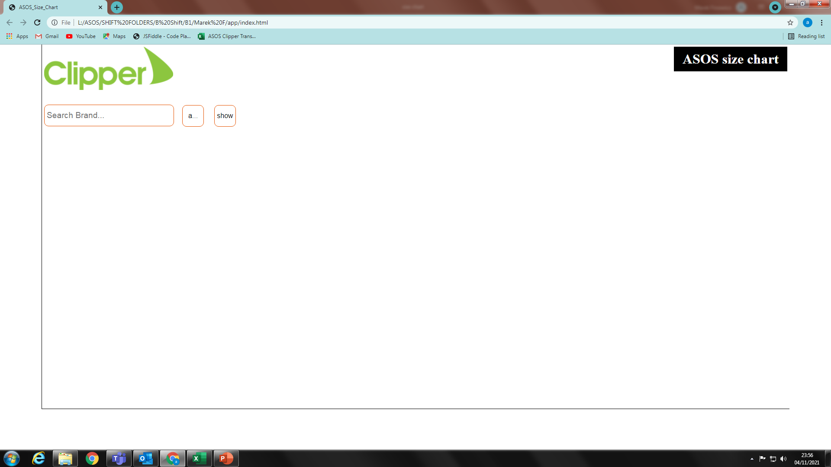
Size Chart
1. Panel of size searcher visible when opened in Chrome

Slide 3
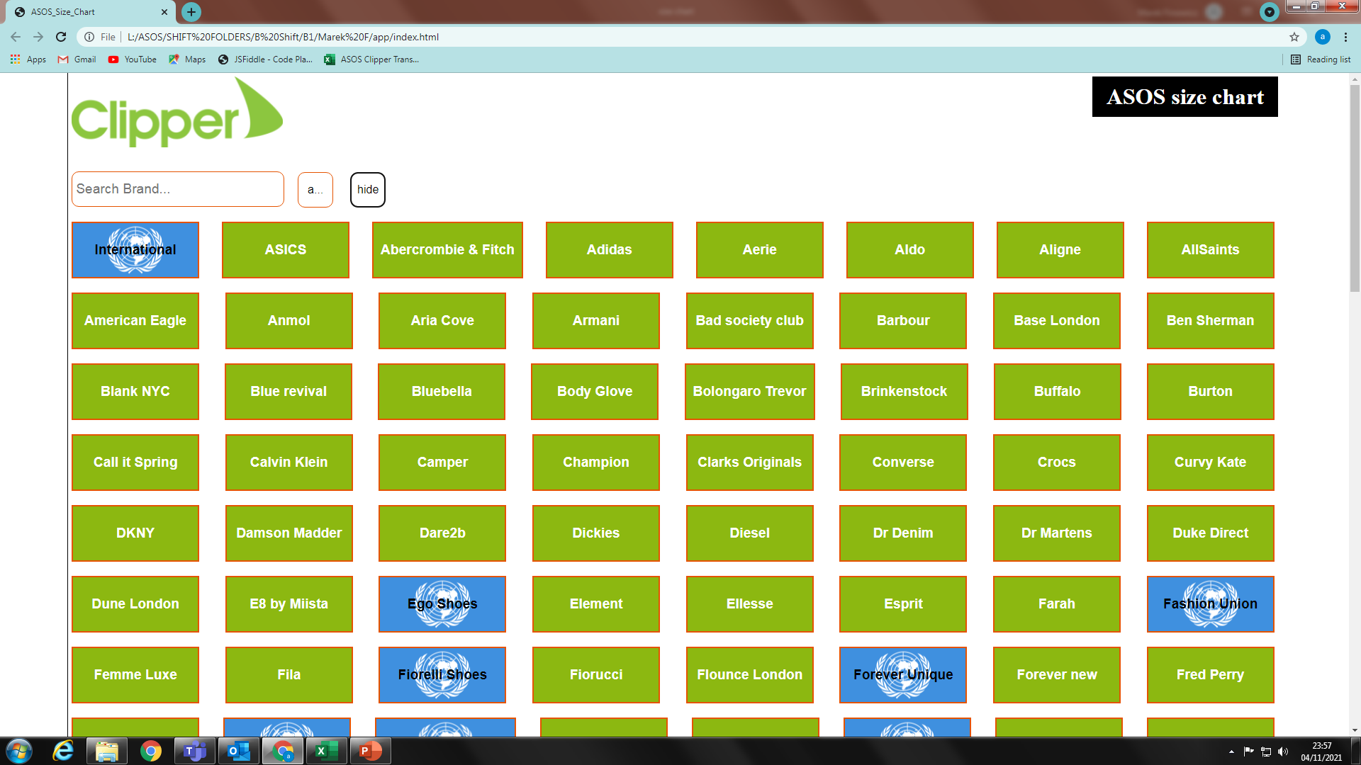
Size Chart
2. By default all brands are hidden. If you press button ‘show’ all of them will become visible. If you press ‘hide’ they will become hidden

Slide 4
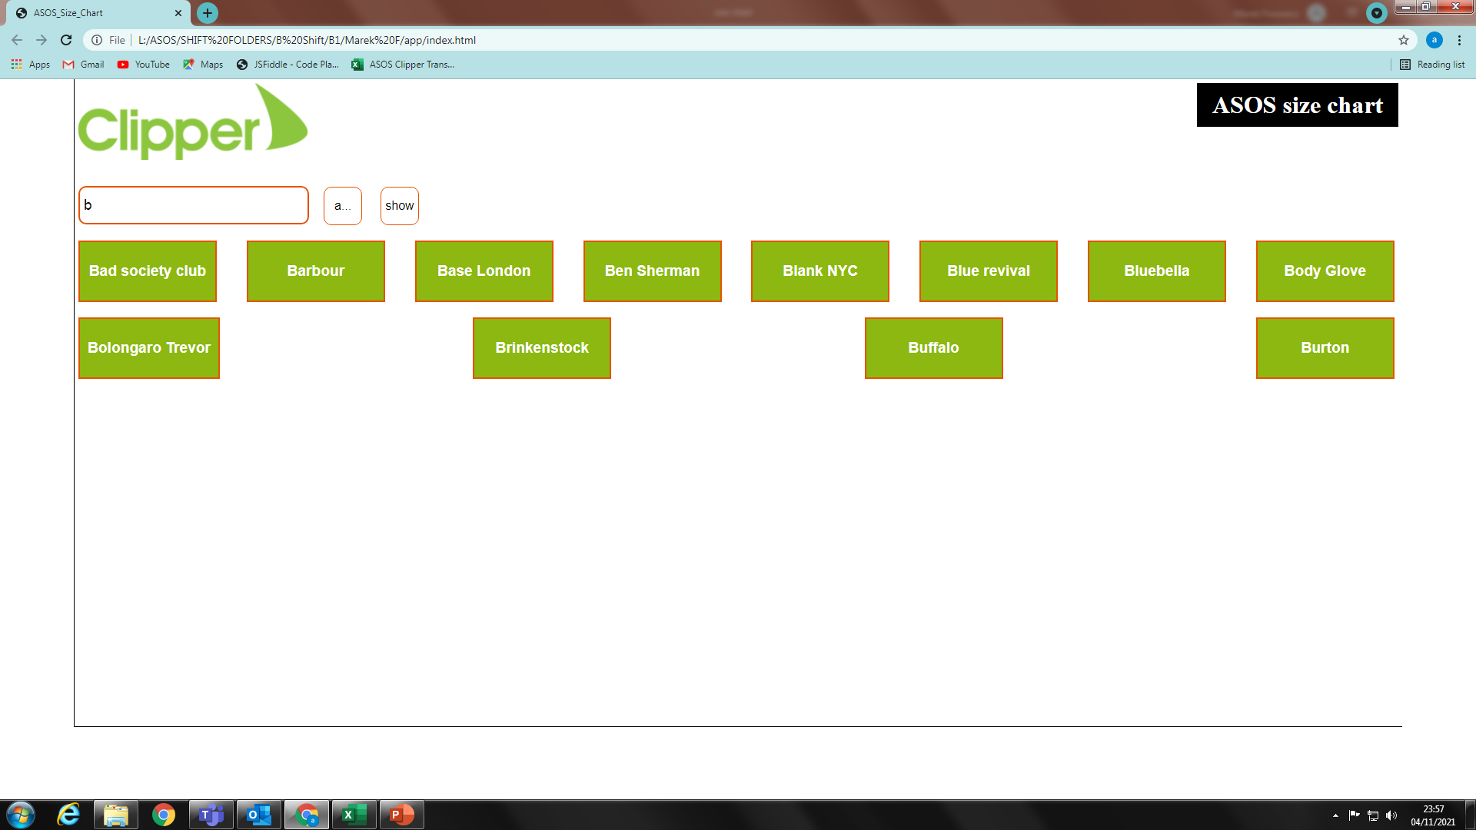
Size Chart
3. There is search mode button(a…) next to search box. In default state it will allow to search brands from beginning of brand name in alphabetic order.

Slide 5
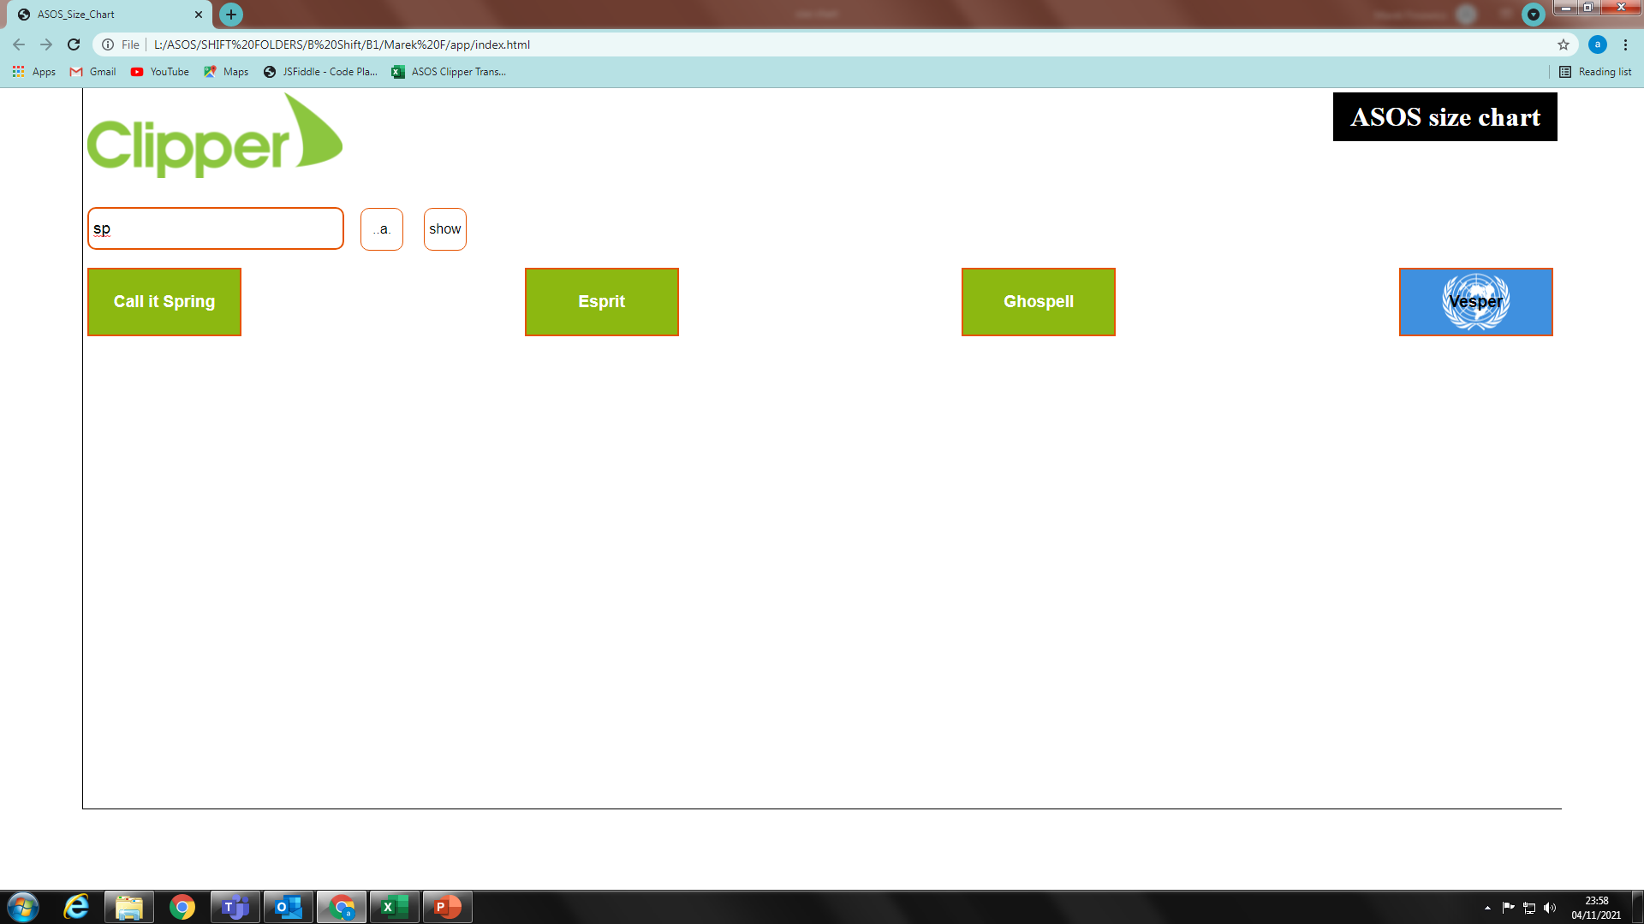
Size Chart
4. If you press search mode button it will change to (..a.) and will allow to search phrase anywhere in brand name.

Slide 6
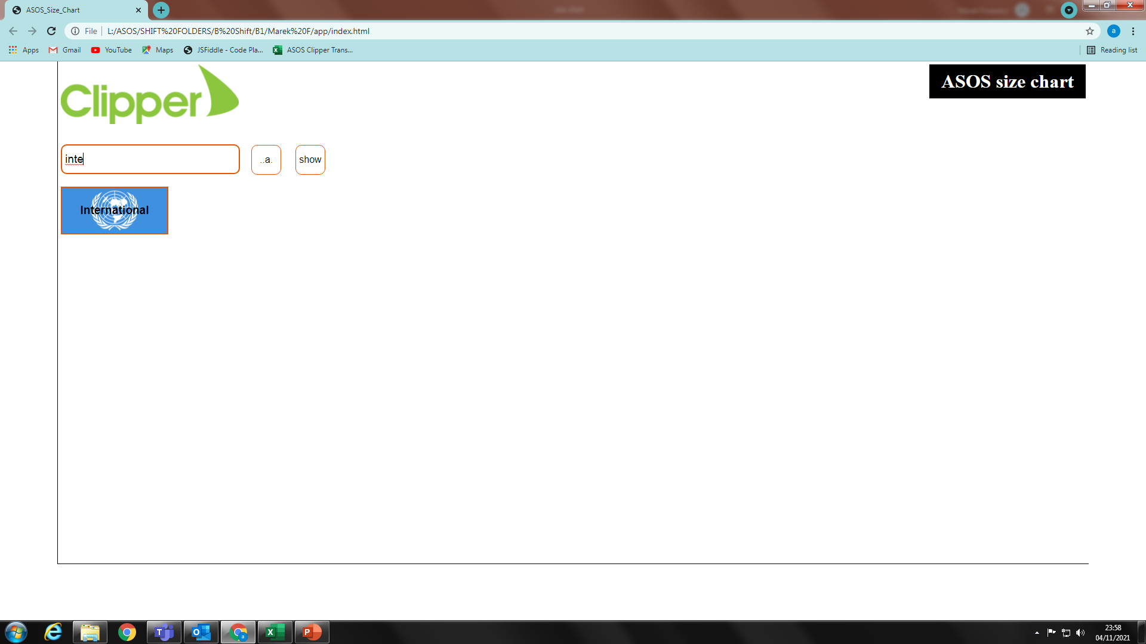
Size Chart
5. Brand button with UN flag mean that that brand has international size chart.

Slide 7
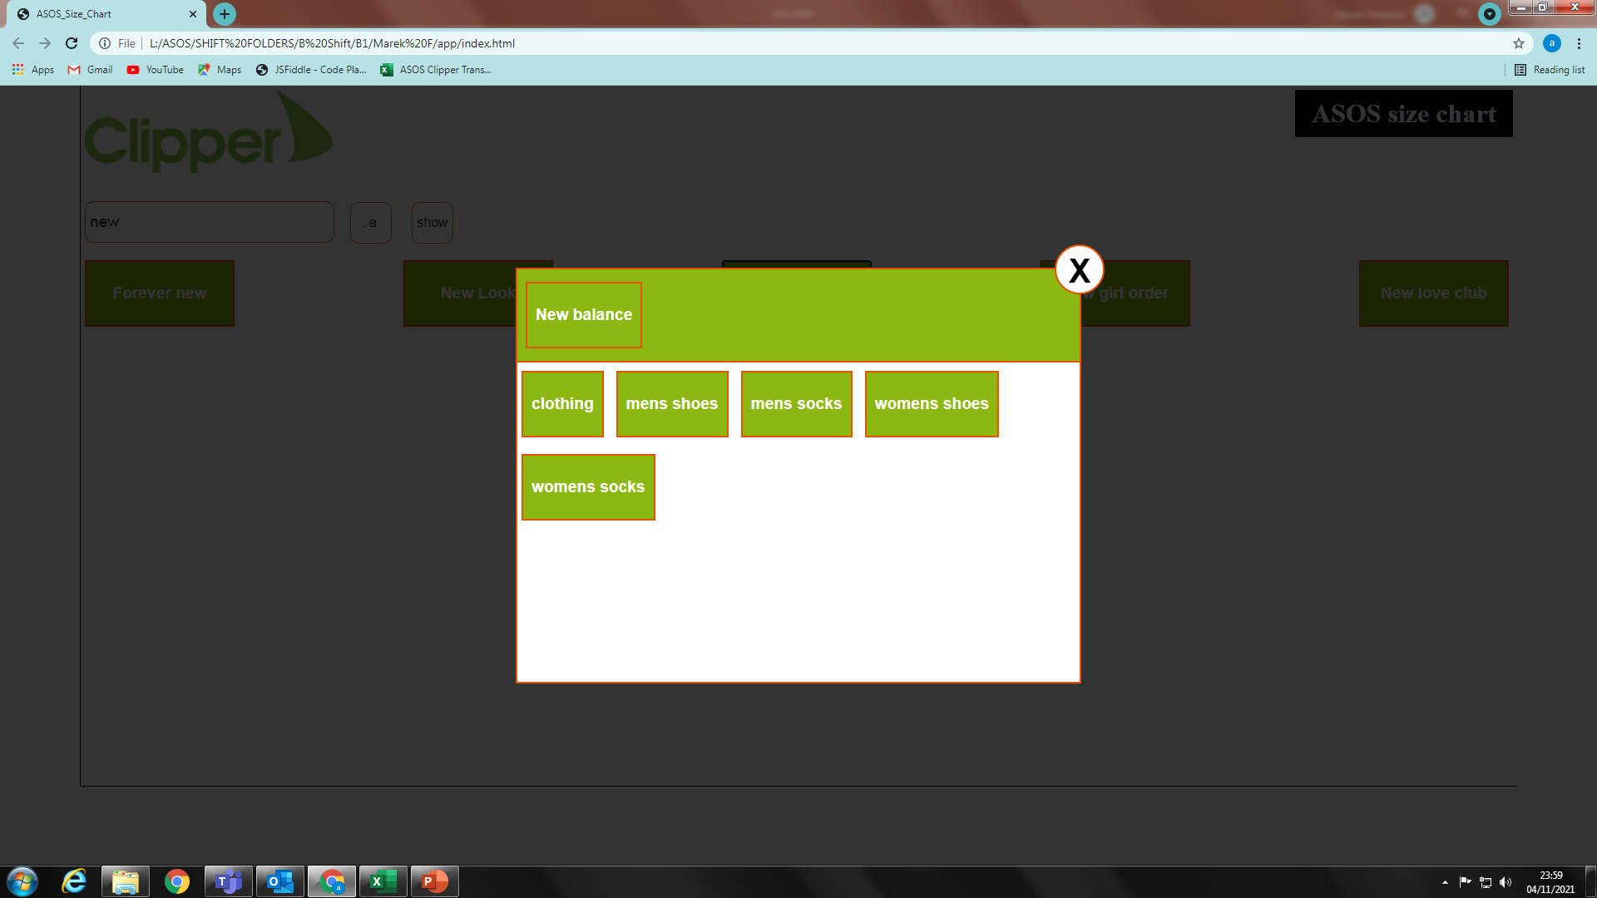
Size Chart
6. Once you click chosen brand button, you will see panel with products.

Slide 8
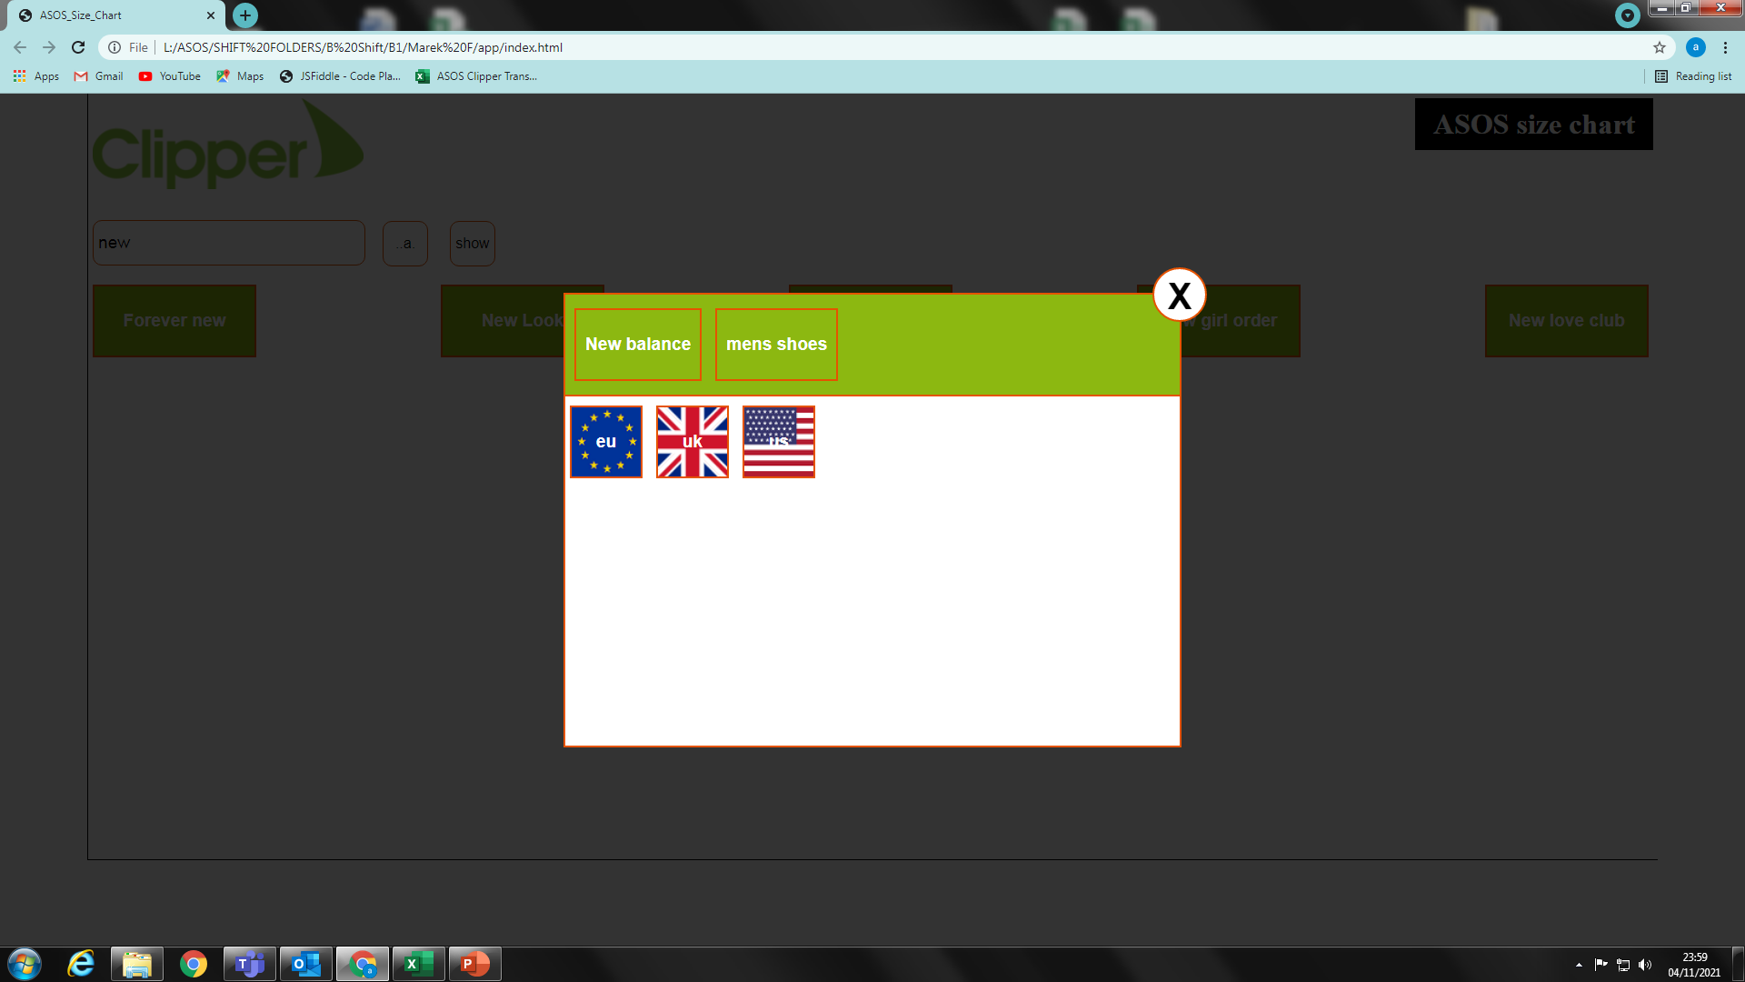
Size Chart
7. If you click brand product button you will see available sizes charts

Slide 9
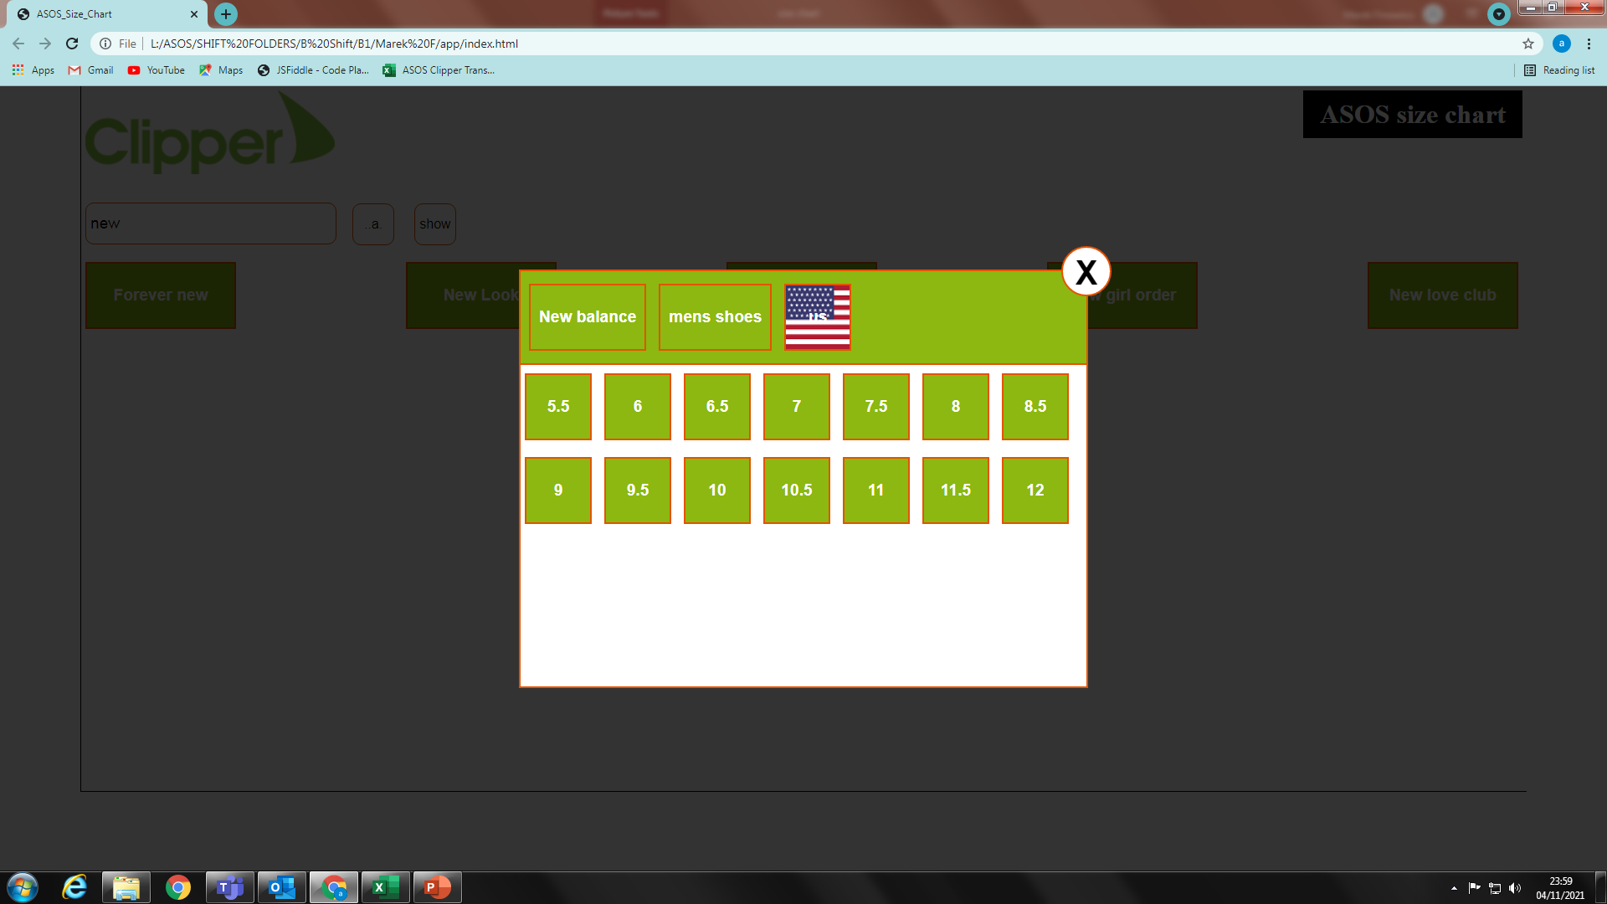
Size Chart
8. Once you choose size chart that you looking for (i.e. us) you will see all size numbers for product (i.e. New balance men's shoes)

Slide 10
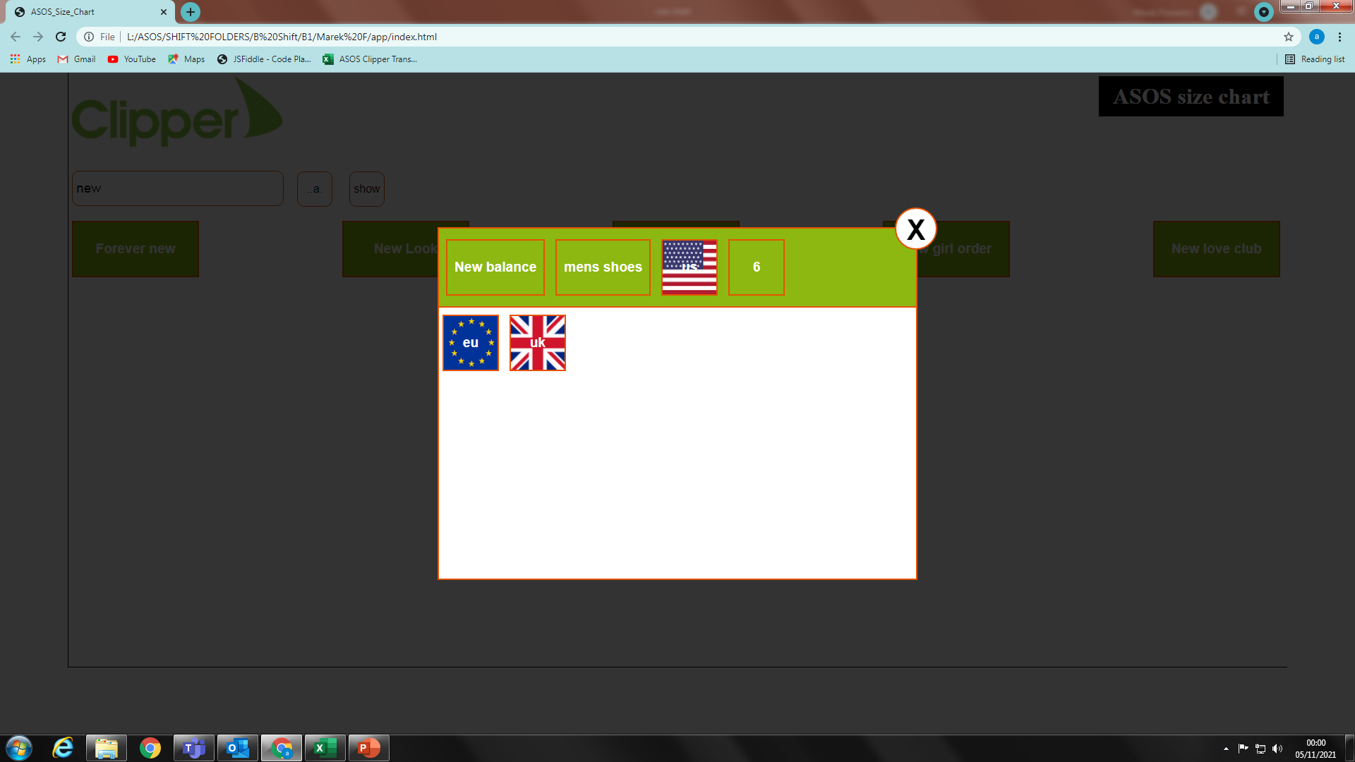
Size Chart
9. When you click size number you will see remaining size charts (i.e. uk, eu)

Slide 11
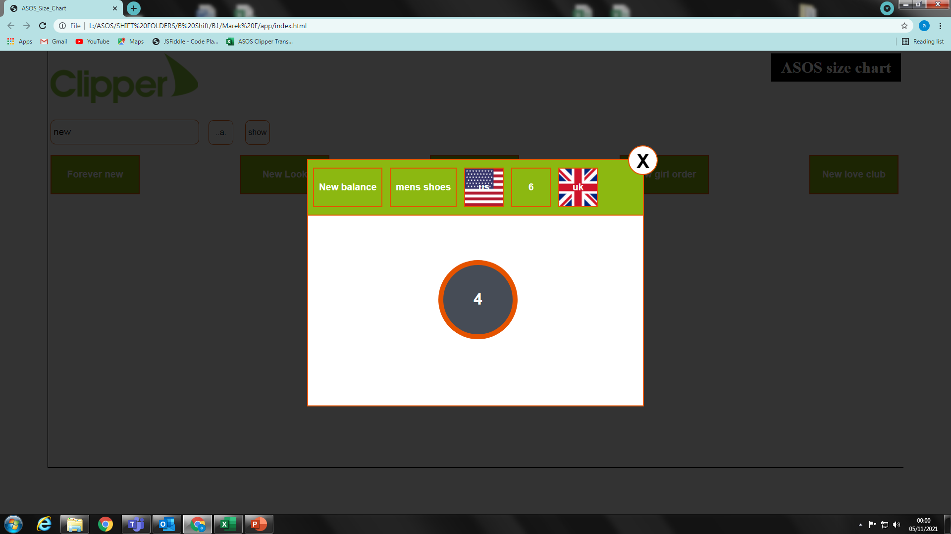
Size Chart
10. Once you click size chart it will show you correct size. All steps are visible on top green area. In case below ‘us’ 6 was converted to ‘uk’ 4.

